Slide 1
Introduction to Linear Regression
Dr. “You Better Walk the Line” Schroeder

Slide 2
Relationships
Just like viewing things as “ordinary or not” is a necessity of the human condition, so is looking at the relationships between things
It’s a great shortcut
Imagine if you had to wonder every time you got in your car what was going to happen when you step on the accelerator
Instead, we assume a relationship exists that we can count on – we don’t need to rethink it every time
The concepts of average and deviation are simply statistical formalizations of “ordinary or not”
Linear Regression is simply a statistical formalization of the concept of relationship

Slide 3
Many public management problems can be interpreted as relationships between two variables
Highway patrol might want to know whether the avg. speed of motorists is related to the number of cars on patrol
Knowing this could lead to decision to increase/decrease patrols
A state wants to raise the beer tax and wants to know how much revenue it would generate
If a relationship exists between, say, population and revenue from beer tax, then a “prediction” can be made as to how much revenue the state could expect to receive

Slide 4
Functional vs. Statistical
Relationships can be categorized as functional or statistical
Functional Relationship
one variable (Y) is a direct function of another (X)
Statistical Relationship
one where knowing the value of an Independent variable will let you estimate a value for the Dependent variable

Slide 5

Functional Relationship
Cooter Davenport, the head of the Hazard County motor pool, believes there is a relationship between the number of cars he sends over to a local tune-up shop and the amount of the bill that he receives
Cooter finds the information for the last five transactions with the tune-up shop
Data from Tune-Up Shop
Number of Cars | Amount of Bill
2 | $64
1 | 32
5 | 160
4 | 128
2 | 64

Slide 6
Functional Relationship
Cooter, having recently audited a methods course, knows the first step you should always take in determining whether two variables are related is to graph the two variables
When graphing, the Independent variable (X) is always graphed along the bottom horizontally, and the Dependent variable is always graphed along the side vertically

Slide 7
Functional Relationship
Task
Go ahead and graph Cooter’s data
Data from Tune-Up Shop
Number of Cars | Amount of Bill
2 | $64
1 | 32
5 | 160
4 | 128
2 | 64

Slide 8
Functional Relationship
What was the result?
The data should fall without deviation along a single line
This is a characteristic of a functional relationship
If you know the value of the independent variable, then you know, exactly, the value of the dependent variable
The tune-up shop charges $32 to tune up a car, so the bill is simply $32 times the number of cars

Slide 9
Statistical Relationships and Regression
Unfortunately, VERY FEW of the important relationships that public managers must consider are functional
Most relationships are Statistical
Knowing the Independent variable only lets us estimate the Dependent variable
One tool (process) for determining the exact nature of a statistical relationship is called Regression

Slide 10
Statistical Relationships and Regression
Example
The Commissioner of VDOT believes the average speed of motorists along a stretch of I-81 is related to the number of cars patrolling that stretch
Average speed is measured by and unmanned, stationary radar gun
Experiment spans 2 months with measurements taken daily
A sample of 5 days is taken
Commissioner's Data
Number of Cars Patrolling | Average Speed of Motorists
3 | 64
1 | 71
4 | 61
5 | 58
7 | 56

Slide 11
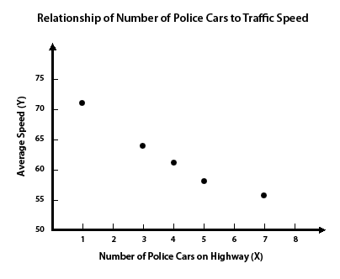
Statistical Relationships and Regression
The first step is to plot the data on a graph to see if we SEE a relationship
This is called “Eyeballing”

Slide 12
Statistical Relationships and Regression
Clearly, a relationship seems to exist
The more patrol cars on the highway, the lower the average speed
What kind of relationship is this?
Negative

Slide 13
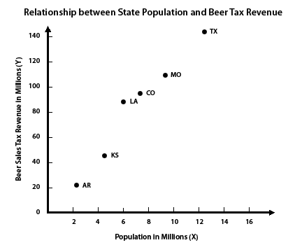
Statistical Relationships and Regression
Another example
Our hypothetical beer tax scenario illustrates a positive relationship
We can see that as states’ populations increase, so do the revenues from the beer tax

Slide 14
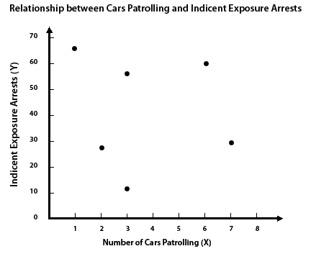
Statistical Relationships and Regression
Many times, no relationship exists between two variables
Here’s a graph of the data relating the number of patrol cars to the number of indecent exposure arrests
Need to look at data

Slide 15
Statistical Relationships and Regression
OK, what if there was a national Public Administration conference held in town on Wed-Fri (these folks are known to be wild) and graduation from a local University was on Saturday?
How might you control for such things?
Patrol Cars and Number of Arrests
Day | Cars on Patrol | Indecent Exposure Arrests
Monday | 2 | 27
Tuesday | 3 | 12
Wednesday | 3 | 57
Thursday | 7 | 28
Friday | 1 | 66
Saturday | 6 | 60

Slide 16
Eyeballing
You can figure out a lot by first graphing the two variables and taking a gander
You can generally tell pretty quickly when a VERY STRONG or VERY WEAK IF ANY relationship exists
However, many situations will fall somewhere in between
That’s when you need to have a set of statistics on hand to help you summarize the data

Slide 17
Centrality and Spread
Remember, to describe some data about ONE variable accurately, we need two things
A measure of Centrality
And a measure of Spread
When doing regression, even though it is more difficult (because we are now dealing with TWO data sets), we are still trying to find the same things!

Slide 18
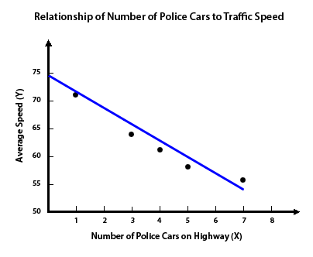
Statistical Relationships and Regression
The measure of Centrality, when we are dealing with TWO variables, is
a LINE

Slide 19
Statistical Relationships and Regression
For our example of patrol cars on I-81, we see that we can pretty easily draw a line that can “sum up” the relationship between the two variables
The line represents the “average” outcome of Y for any given X

Slide 20
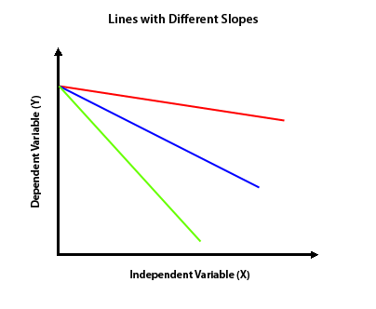
Statistical Relationships and Regression: Two Numbers Describe a Line
Any line can be described by two numbers
The 3 lines here differ in how steeply they “slant”
This slant is referred to a Slope

Slide 21
Statistical Relationships and Regression: Two Numbers Describe a Line
The slope of any line is defined by how much the line rises or falls relative to the distance it travels horizontally

Slide 22
Statistical Relationships and Regression: Two Numbers Describe a Line
Statistically, the formula is
Remember “rise over run”?
Because we are most often dealing with samples, we use the symbol “b”
In geometry, it was “m”

Slide 23
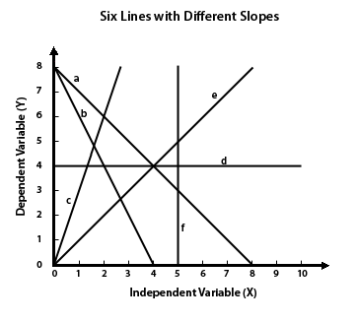
Statistical Relationships and Regression: Two Numbers Describe a Line
Here are several hypothetical lines
Go ahead and calculate the slopes

Slide 24
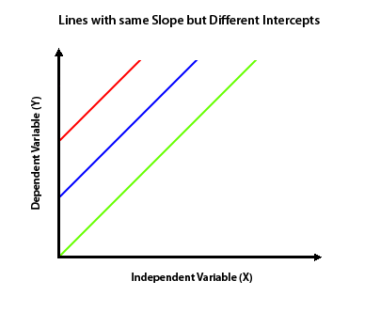
Statistical Relationships and Regression: Two Numbers Describe a Line
The second number used to describe a line is the point where it crosses the Y-axis
This is where X = 0
It’s called the Intercept
Here are several lines with the same slope, but different intercepts

Slide 25
Statistical Relationships and Regression: Two Numbers Describe a Line
Statistically, we refer to the intercept with the Greek letter alpha “α”
Since we are usually dealing with samples, we instead use “a”
In geometry you used “b”, how’s that for confusing?

Slide 26
Statistical Relationships and Regression: Two Numbers Describe a Line
So, a line can be described as
If you are describing a relationship, then it’s

Slide 27
Statistical Relationships and Regression: Two Numbers Describe a Line
The little “hat” means “predicted value”
Because we are usually dealing with samples, we use
In geometry it was Y=mX + b, go figure

Slide 28
Statistical Relationships and Regression: Two Numbers Describe a Line
To illustrate, let’s look at the car speed example again
If we had only the line, what could we say about the expected average speed if 3 patrol cars were on the road?

Slide 29
Statistical Relationships and Regression: Two Numbers Describe a Line
Note that the actual value for that day is 64
There is going to be some error in predicting Y
Just like if we use the mean to predict a parameter

Slide 30
Statistical Relationships and Regression: Two Numbers Describe a Line
It’s often very hard to accurately eyeball a line
Sometimes, multiple lines look they might do the trick
Statisticians have figured out that the best line to approximate a relationship between two variables is the one that minimizes the errors between Y and Y “hat”
This is called “Linear Regression” or “Ordinary Least Squares”

Slide 31
Statistical Relationships and Regression: Two Numbers Describe a Line
The two formulas that determine a line according to linear regression are
The slope
The intercept

Slide 32
Statistical Relationships and Regression: Two Numbers Describe a Line
The Slope
Taken a piece at a time, this formula is not as intimidating as it looks
Example – Patrol Cars vs. Speed
Step 1
Calculate the mean for both the dependent variable (Y) and the Independent variable (X)
Commissioner's Data
Number of Cars Patrolling (X) | Average Speed of Motorists (Y)
3 | 64
1 | 71
4 | 61
5 | 58
7 | 56
mean = 4 | mean = 62

Slide 33
Statistical Relationships and Regression: Two Numbers Describe a Line
Step 2
Subtract the mean of the dependent variable from each value of the dependent variable
Do the same for the independent variable
3 - 4 = -1 | 64 – 62 = 2
1 – 4 = -3 | 71 – 62 = 9
4 – 4 = 0 | 61 – 62 = -1
5 – 4 = 1 | 58 – 62 = -4
7 – 4 = 3 | 56 – 62 = -6
3 - 4 = -1 | 64 – 62 = 2
1 – 4 = -3 | 71 – 62 = 9
4 – 4 = 0 | 61 – 62 = -1
5 – 4 = 1 | 58 – 62 = -4
7 – 4 = 3 | 56 – 62 = -6

Slide 34
Statistical Relationships and Regression: Two Numbers Describe a Line
Step 3
Multiply the value you get when you subtract the mean from X_{i} by the value you get when you subtract the mean from Y_{i}
Step 4
Sum em up! You should get -51
We now have the numerator (the one on top)
-1 x 2 = -2
-3 x 9 = -27
0 x -1 = 0
1 x -4 = -4
3 x -6 = -18

Slide 35
Statistical Relationships and Regression: Two Numbers Describe a Line
Step 5
Use the (X_{i} – X_{bar}) column from step 3, and square each value
Step 6
Sum em up!
You should get 20
We now have the denominator (the one on the bottom)
3 - 4 = -1 | 1
1 – 4 = -3 | 9
4 – 4 = 0 | 0
5 – 4 = 1 | 1
7 – 4 = 3 | 9

Slide 36
Statistical Relationships and Regression: Two Numbers Describe a Line
Step 7
Divide the numerator by the denominator!
Your slope is -2.55

Slide 37
Statistical Relationships and Regression: Two Numbers Describe a Line
The Intercept
Much easier
Just substitute in the three values you already have for b, the mean of X and the mean of y
The intercept is 72.2

Slide 38
Statistical Relationships and Regression: Two Numbers Describe a Line
So, the regression equation that describes the relationship between the number of patrol cars and average speed on a stretch of I81 is:

Slide 39
Applying the Regression Equation
The regression equation provides a lot of information
Suppose the VDOT commissioner wants to know the estimated average speed of traffic if six patrol cars are placed on duty
Just plug it in to your new equation
We can expect an average speed of 56.9

Slide 40
Applying the Regression Equation
How much would the mean speed for all cars decrease if one additional patrol car were added?
Hint: every time you add one car, it gets multiplied by this
The regression coefficient is the slope
In management, it is interpreted as “How much will Y change for every unit change in X?”

Slide 41
Applying the Regression Equation
What would be the average speed if no patrol cars were on the road?
This means when X = 0
Another way to state it is “What is the Y-intercept?”

Slide 42
Regression Example
While you will usually use Excel or a stats program to calculate regression equations, it is a good idea to calculate some by hand so that you understand what it is the computer is doing for you
As we’ve seen in the previous walkthrough, it’s not that difficult

Slide 43
Regression Example
Using the provided worksheet, create the regression equation that describes the relationship between a state’s population and its beer tax revenue

Slide 44
Linear Regression Measures of Goodness of Fit
When we use a mean to summarize the data of one variable, it is meaningless without some measure of the dispersion of the data around that mean (e.g. standard deviation)
The same holds for linear regression
While a line can be used to describe the relationship between two variables, it does not, by itself, tell us how well it is summarizing the data

Slide 45
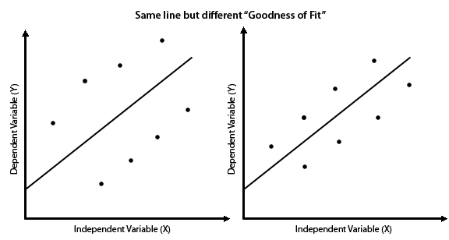
Linear Regression Measures of Goodness of Fit
To illustrate, the two sets of data above can be summarized by the same regression line
However, we can see that the data has a “better fit” around the line of the second graph

Slide 46
Linear Regression Measures of Goodness of Fit
The distance a data point is from the regression line is its error
Recall that
Measures of Goodness of Fit are what statisticians have come up with to describe the amount of error in predictions made by our regression equation

Slide 47
Linear Regression Measures of Goodness of Fit
Error, when we are talking about regression equations, is referred to as Unexplained Variance
That is, it’s the part that knowing X can’t explain

Slide 48
Linear Regression Measures of Goodness of Fit
Where does error come from?
It is very rare that a single independent variable will account for all the variation in a dependent variable
The unemployment rate might explain a substantial portion of the variation in demand for services at a local food bank, but other variables such as higher retail food prices and climate (such as cold weather) might also account for some of the variation in demand
Data values will not fall perfectly along a regression line if the independent variable only explains some of the variation in the dependent variable

Slide 49
Linear Regression Measures of Goodness of Fit
Measuring goodness of fit of the data around a regression equation IS more complicated than measuring dispersion around a mean
This is because there are multiple places for the things to vary
Specifically, there are two major places that error can be a factor

Slide 50
Linear Regression Measures of Goodness of Fit
How much an estimate is off from the actual data point is called a “residual”
There are two methods to analyze how much residual error there is
Standard Error of the Estimate
Coefficient of Determination
Residual

Slide 51
Linear Regression Measures of Goodness of Fit
The angle of the slope (the regression coefficient) can also be off
The method used to asses this is called the Standard Error of the Slope
Error in the Slope

Slide 52
The Standard Error of the Estimate
A calculation of the variation in the predicted Ys (the estimates)
Basically the standard deviation of linear regression (sums up the squared differences from the line and divides by n; actually n-2, but you get the idea)
Can be used to put confidence bands around the regression line

Slide 53
The Standard Error of the Estimate
The formula is
If you put Y-bar in the place of Y-hat, you almost exactly have the equation for standard deviation

Slide 54
The Standard Error of the Estimate
To illustrate
Using data from car speed example
Step 1
First we need to find all the predicted Ys for our Xs
That means we plug in our values of X into the regression equation we made
Number of Cars Patrolling (X) | Average Speed of Motorists (Y)
3 | 64
1 | 71
4 | 61
5 | 58
7 | 56
mean = 4 | mean = 62

Slide 55
The Standard Error of the Estimate
To illustrate
Using data from car speed example
Step 1
First we need to find all the predicted Ys for our Xs
That means we plug in our values of X into the regression equation we made
Number of Cars Patrolling (X) | Average Speed of Motorists (Y) | Predicted Speed of Motorists (Y-hat)
3 | 64 | 64.6
1 | 71 | 69.7
4 | 61 | 62.0
5 | 58 | 59.5
7 | 56 | 54.4

Slide 56
The Standard Error of the Estimate
Step 2
Now we can subtract each Y-hat from the actual Y
Step 3
Square the errors found in step 2 and sum them up
Number of Cars Patrolling (X) | Average Speed of Motorists (Y) | Predicted Speed of Motorists (Y-hat)
3 | 64 | 64.6 | .36
1 | 71 | 69.7 | 1.69
4 | 61 | 62.0 | 1.00
5 | 58 | 59.5 | 2.25
7 | 56 | 54.4 | 2.56
 |  | ∑ | 7.86

Slide 57
The Standard Error of the Estimate
Step 4
Divide by n-2
Step 5
Take the square root
The Standard Error of the Estimate is 1.62

Slide 58
The Standard Error of the Estimate
OK, so, yippee, I have a regression equation and a Standard Error of the Estimate, now what?
Well, suppose the VDOT commissioner wanted to predict the average speed of all cars when three patrol cars were on the road
Using the regression equation, the commish would find
Y = 72.2 – 2.55(3) = 64.55 mph

Slide 59
The Standard Error of the Estimate
Y = 72.2 – 2.55(3) = 64.55 mph
But how “confident” can the commish be in that estimate?
Now that we have the Standard Error of the Estimate, we can answer that
Lets say the commish wanted to be 90% confident
Degrees of freedom for regression is n – 2, (5 – 2 = 3)
Look up the t-score for .10 at 3df
If you have a chart that shows only one-tailed, then look under .05 at 3df
You should get 2.35
Multiply that by your Standard Error 2.35 x 1.62 = 3.81
The commish can be 90% confident that the speeds will be 64.55 mph ± 3.81 mph

Slide 60
Not exactly, but close “enuf”
This formula is most accurate at the middle of the line
With smaller n, the confidence bands actually bow
As n gets higher, the bow goes away
Much fancier formula that takes the bow into account
Your computer program will automatically do this for you

Slide 61
The Coefficient of Determination
The ratio of Explained Variation to the Total Variation
Explained variation is nothing more than the total variation minus the error
The formula is
It ranges from 0 (the line doesn’t fit the data at all) to 1 (the line perfectly describes the data)

Slide 62
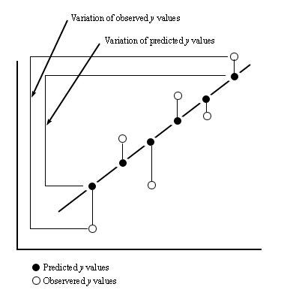
The Coefficient of Determination
Your looking at the difference between the variation in you predicted scores around the mean vs. the variation in the actual scores around the mean

Slide 63
The Coefficient of Determination
Think about it this way
If someone wanted to guess the next value of Y but gave you no information, you would have to guess the mean
If someone asked you to guess the next value, but gave you an X and a regression equation, you could probably get closer to the actual value than just guessing the mean
The difference between these two is what r² is measuring

Slide 64
The Coefficient of Determination
Y_{bar} = 62
Y_{hat} (predicted) | Y (actual) | (Y_{hat} – Y_{bar} )² | (Y – Y_{bar} )²
64.6 | 64
69.7 | 71
62.0 | 61
59.5 | 58
54.4 | 56
 | ∑
r² =

Slide 65
The Coefficient of Determination
What’s is good for?
Kind of a one-stop shopping stat
Some % of Y is “explained” by X
Most useful for comparing one model to the next when trying to figure out which Independent variable is the most important
Or for figuring out if you need to go find more variables!
Actually quite overused

Slide 66
The Standard Error of the Slope
Whereas the Standard Error of the Estimate is like the Standard Deviation, the Standard Error of the Slope is like the Standard Error, goofy language huh?
If we took several samples of an independent and dependent variable and calculated a slope, it would be a little different every time

Slide 67
The Standard Error of the Slope
Just like the Standard Error is an estimate of variation based on the Sample Distribution of Means, the Standard Error of the Slope also relates the sample to a sample distribution
Therefore, just like we can use the s.e. of a single variable data set to create a t-score and test a hypothesis, we can do the same for our regression equation

Slide 68
The Standard Error of the Slope
The formula is:
You already have the numerator (it’s the Standard Error of the Estimate)
X
3
1
4
5
7
∑
s_{b} =

Slide 69
The Standard Error of the Slope
So what’s it good for?
Just like the Standard Error of the Estimate, you could multiply it by 2.35 and get a 90% confidence band around your estimate of the slope (-3.40 to -1.70)
More importantly, you can do a significance test with it to test a hypothesis

Slide 70
The Standard Error of the Slope
The Null Hypothesis for a regression equation is always β=0 (that is, that the slope of the population is 0, or that there is no relationship between the two variables)
So, to get a t-score, you just subtract 0 from your slope (b) and divide by the standard error of the slope (s_{b})
Give it a shot!

Slide 71
The Standard Error of the Slope
Now, look at a t-distribution table for 3 degrees of freedom
How far over can you go before you get higher than the t-score you just got?
Should be something like .005
That means the probability that a sample with a slope of -2.55 could have been drawn from a population with a slope of zero is less than .005 (5 in 1000)
Pretty good odds that some form of relationship exists!

Slide 72
The Standard Error of the Slope
Sometimes a regression equation is computed on a whole population
Remember, when this is the case, any finding is %100 probable (you are not estimating with error)
You don’t need to test for significance in this case
Many times, you will still see this done
This is goofy and shows that they have no idea why they are running the tests they are running
I’m sure it won’t directly effect their self esteem, but stats geeks are laughing at them

Slide 73
To summarize
Regression describes the relationship between two interval variables
The relationship can be described by a line
Any line can be summarized by its slope and intercept
“Linear” regression finds the line by minimizing the error around the line
The three techniques used to test the “Goodness of Fit” of the data around the line are:
The Standard Error of the Estimate which estimates the variation in the predicted values of Y
The Coefficient of Determination which gives you a total reading of the variation in Y and ranges from 0-1
The Standard Error of the Slope which can be used to test the null hypothesis, β=0

Slide 74
Quiz
In my box by noon Tuesday

